Slide 1
ASI & SC
Student Organization Services

Slide 2
Associated Students Incorporated
ASI Board of Directors
OFFICIAL VOICE OF THE STUDENTS! THE BOARD OF DIRECTORS IS COMPRISED OF 14 ELECTED STUDENTS WHO REPRESENT AND ADVOCATE ON BEHALF OF THE STUDENT BODY.
Services Funded by ASI
ASI IS COMMITTED TO PROVIDING SERVICES THAT ENHANCE THE STUDENT EXPERIENCE.
Notes:
Maria

Slide 3
University Student Center
FACILITY/ OPERATIONS
THIS TEAM IS DEDICATED TO PROVIDING SERVICES AND SPACES WHITHIN THE UNIVERSITY STUDENT CENTER TO ENHANCE THE STUDENT COLLEGE EXPERIENCE.
SC BOARD OF DIRECTORS
9 STUDENT REPRESENTATIVES WHO MAKE DECISIONS CONCERNING THE UNIVERISTY STUDENT CENTER POLICIES, RENOVATIONS, MARKETING, AND BUDGETARY ITEMS.
SERVICES FUNDED BY SC
THE UNIVERSITY STUDENT CENTER OFFERS MANY SERVICES OUT OF THE STUDENT CENTER BUDGET AND SERVICE DESK
Notes:
Maria

Slide 4
Trust Accounts on Campus
ASI is your Liaison
when contacting Business and Finance and Student Leadership Development on campus regarding Trust Accounts
Check Request Forms
Advance Check
Reimbursements
Payments Directly to a Vendor
Depositing Funds to your Trust Accounts: ASI Front Desk
Checking Balance in your Trust Accounts: Contact Michelle Carolan @ mcarolan@csustan.edu
Notes:
Maria

Slide 5
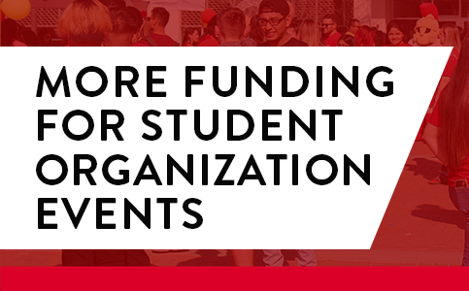
Funding Services
ASI & SC Student Organization Funding-
ASI Provides funding to recognized student organization on campus to host events that benefit and broaden, educational, social, political and cultural experiences for students on campus.
3 Cycles per semester
Student Organizations can request up to $1,500 per academic year
First come first serve basis
Seed Funding-
Startup funding for newly establish recognized student organizations.
Provide $150.00 per student organization
First come first serve basis
Notes:
Maria

Slide 6
Team of in-house graphic designers that can create logos or flyer, A frame, poster, or t-shirt designs
Notes:
Melannie

Slide 7
Giveaways, apparel, and other promotional items needed can be ordered through the ASI Marketing dept.
Notes:
Melannie

Slide 8
In-house printing for posters, banners, flyers, copies
Pricing Details on the ASI Marketing webpage:
https://www.csustan.edu/asi/marketing
Notes:
Melannie

Slide 9
A- frames can be rented to be used as directional signage, event promo, etc.
Can be requested through our A- frame Rental form:
https://bit.ly/3IbM1AK
Notes:
Melannie

Slide 10
Hannah Sawyer
hsawyer@csustan.edu
209-667-3866
Find all details on the ASI Marketing webpage:
https://www.csustan.edu/asi/marketing
Notes:
Melannie

Slide 11
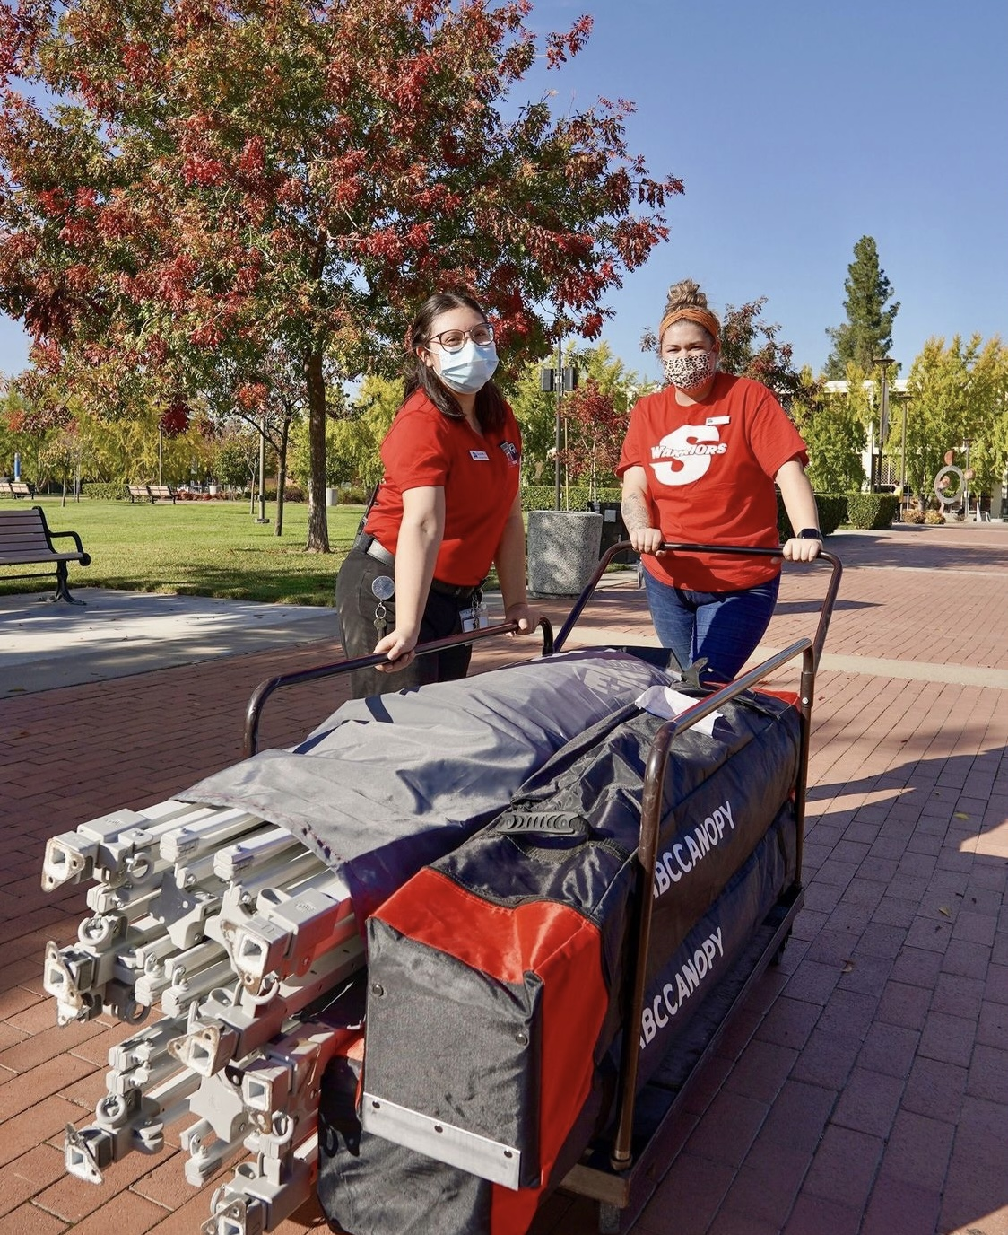
Quad Reservation Request
Quad Booth Space
Tables
Chairs
Awnings
Sound System
Notes:
Miranda

Slide 12
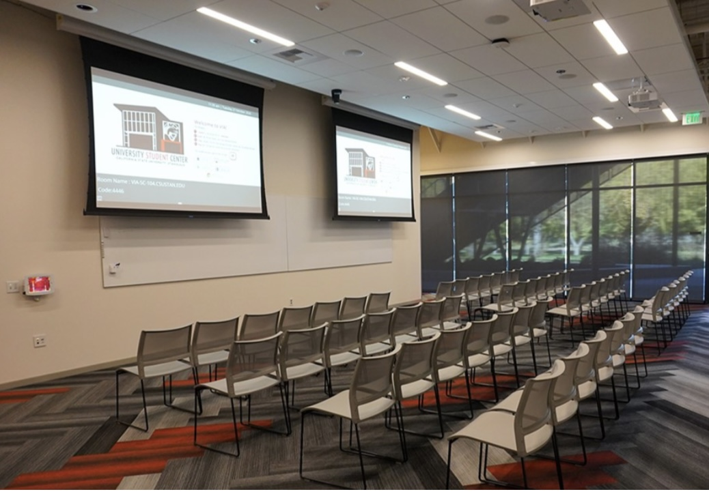
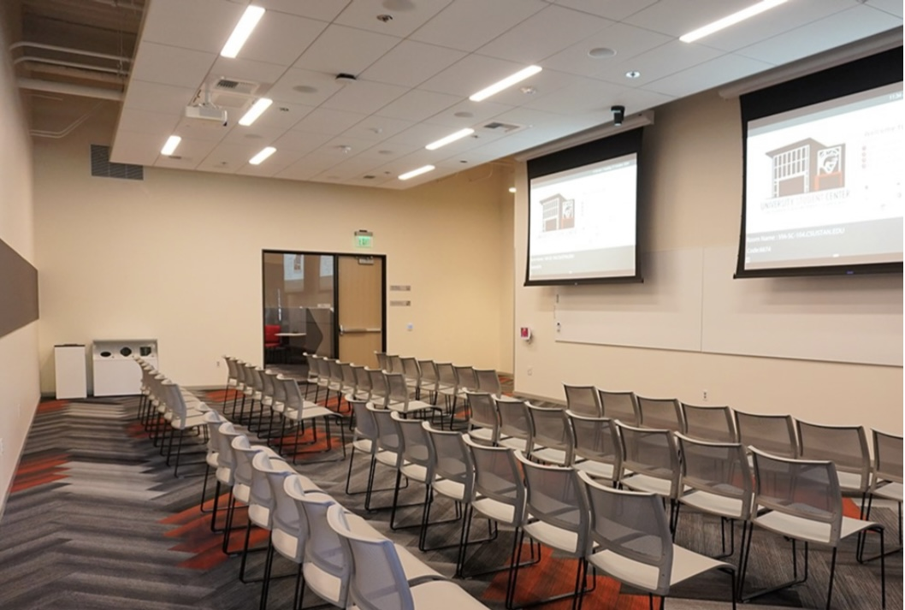
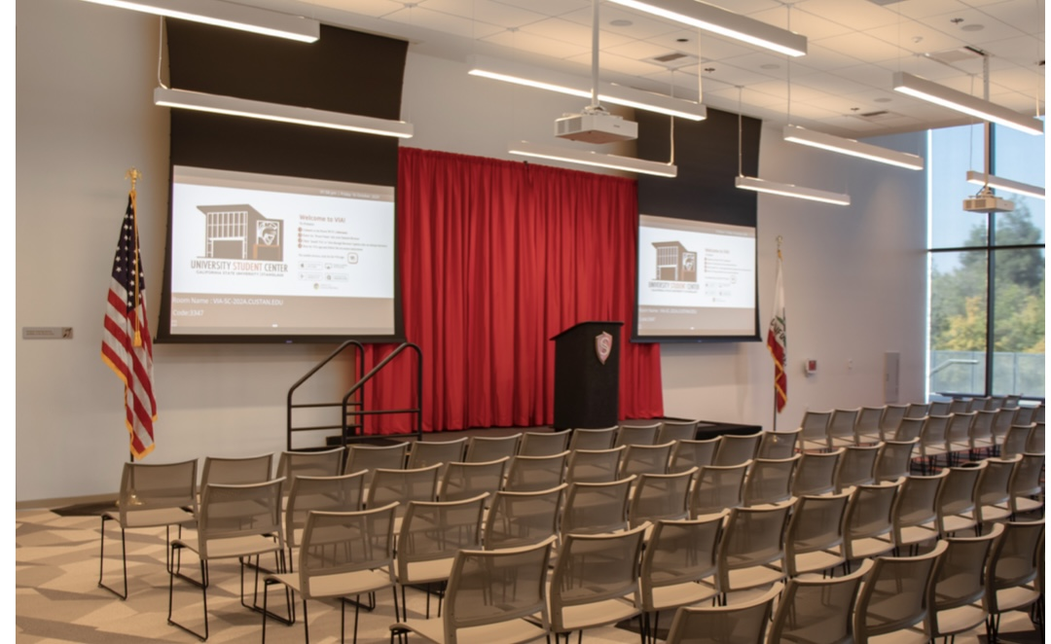
Building Reservations Request
Conference Rooms
Leadership Conference Room (SC 103)
Stanislaus Conference Room (SC 104)
Turlock Conference Room(SC 105)
Gold Conference Room (SC 203)
Red Conference Room (SC 204)
Event Spaces
Valley Conference Room (SC 202A&B)
Event Center
Notes:
Miranda

Slide 13
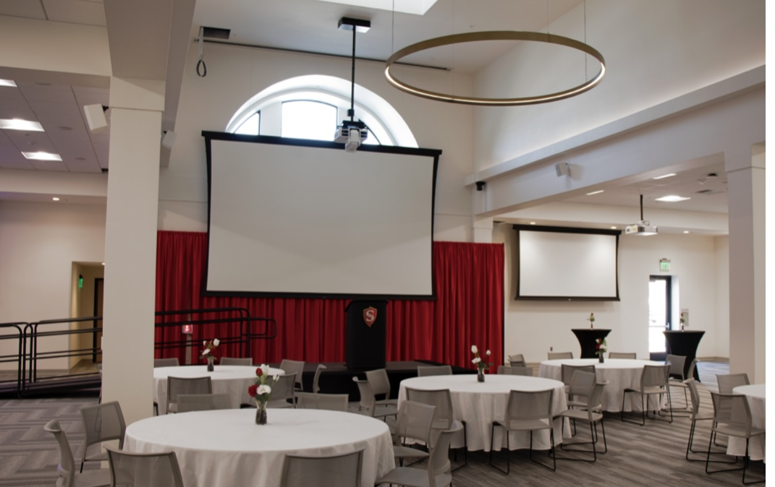
Event Space Equipment Rentals
Indoor Sound System
Projector
Podium
USA & CA Flag
Facility Tables & Chairs
Backdrop
Dance Floor
Spotlight
Stage
Outdoor Sound System
Notes:
Miranda

Slide 14
Notes:
Miranda

Slide 15
Notes:
Miranda

Slide 16
Notes:
Miranda

Slide 17
Notes:
Miranda

Slide 18
Notes:
Miranda

Slide 19
Student Center Reservations
Contact Info
Reservation Student Coordinator
screservations@csustan.edu
Reservations Coordinator
Lyzz Guzman
(209) 667-3832
laguzman@csustan.edu

Slide 20
Questions?

