Slide 1
Recruitment
Tips/Tabling

Slide 2
Let’s Talk About It!

Slide 3
Pros:
Branding
Person in front of booth engaging
Cons:
Distracting person behind booth (on computer connected to charger)
Messy Table Set up (Water bottles, cups, papers)
Chair (off to the side)
No handouts/flyers/takeaway

Slide 4
Let’s Talk About It!

Slide 5
Pros:
Branding
Artifacts
Sign in/Interest sheet
Board display with photos
Smiles!
Cons:
Sunglasses
Satchel/Purse
Water Bottle on table
Food
Conflicting branding

Slide 6
Let’s Talk About It!

Slide 7
Pros:
Branding
Poster (QR Code)
Sign in/Interest sheet
Candy Takeaway
Business Card
Smiles & Standing
Cons:
Book might seem irrelevant
Understaffed
More to display on table

Slide 8
Let’s Talk About It!

Slide 9
Pros:
Consistent Branding
Flyers & Informationals
Cons:
No one is there.
Sign in/Interest sheet missing
Chair & Laptop
Need more to display (Table Top signage, artifacts)

Slide 10
Let’s Talk About It!

Slide 11
Pros:
Branding-Matching shirts/colors, table cloth
Multiple staff
Tabletop signage
Cons:
Unapproachable (Too many staff members in front of table)
Blocking their branding and table
Staff unengaging
Chairs behind table
Table looks messy- Drinks on table
Sunglasses
Lack of enthusiasm

Slide 12
Let’s Talk About It!

Slide 13
Pros:
Branding
Super Clean and visually appealing
Takeaway & incentive
Dimension
Cons:
Display board is not eyelevel
Sign in/Interest sheet not accessible

Slide 14
Let’s Talk About It!

Slide 15
Pros:
Branding
Members in front of booth engaging
Table Top Signage
Sign In/Interest Sheet available
Smiles and Standing
Cons:
Messy- Crooked Table Cloth
Chairs behind booth
More to display, no artifacts, photos
No takeaway/handout

Slide 16
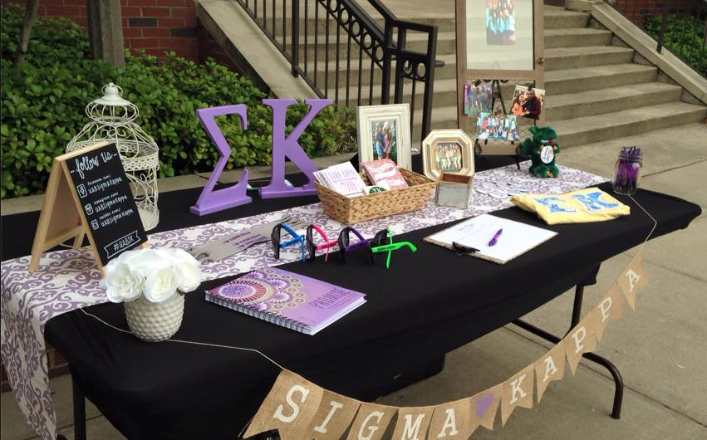
Tabling Must Haves
Sign In/Interest Sheet
Informational Handouts/Takeaways
Branded Signage (What student org is this?
Members
Staying connected information
Good Attitude
* Put it in your tabling kit

Slide 17
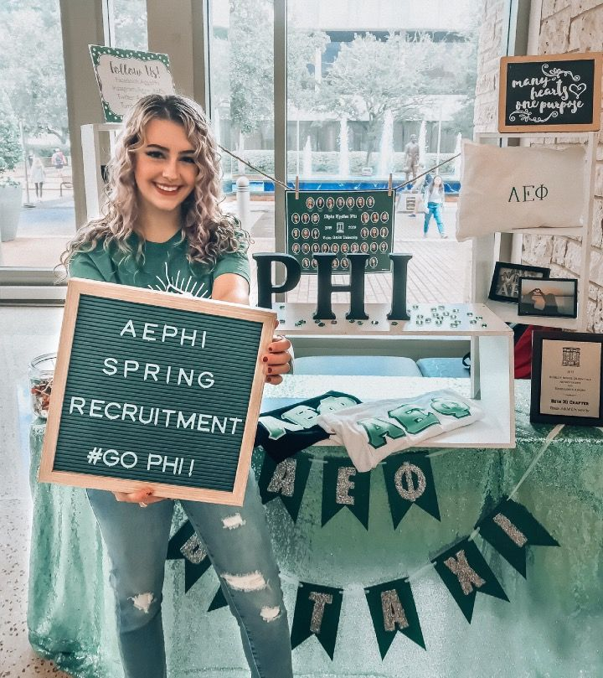
Post Tabling Tips
Follow up with students who signed up for more information!
Recap the Pro’s & Con’s of your event with your members.
Come up with a game plan to improve your next tabling event!

Slide 18
Questions?

