Slide 1
Making your Organization (and events) inclusive
Marvin Williams
August 17, 2022

Slide 2
What is Disability?

Slide 4
"Being disabled does not mean Un-abled, just Different Abled." - Mr. Noel Helm
"Let's stop "tolerating" or "accepting" difference, as if we're so much better for not being different in the first place. Instead, let's celebrate difference, because in this world it takes a lot of guts to be different." - Kate Bornstein
"Disability is not a brave struggle or 'courage in the face of adversity.' Disability is an art. It's an ingenious way to live." - Neil Marcus

Slide 5
“Embracing disability as a normal part of human diversity requires making institutions, norms and legislation inclusive of persons with disabilities, protecting their rights.​
​
But in order to succeed, we must also challenge fears and historical misperceptions about disability, and promote a culture that values diversity as humanity's most precious asset.”​

Slide 6
So, What Do We Do?​

Slide 7
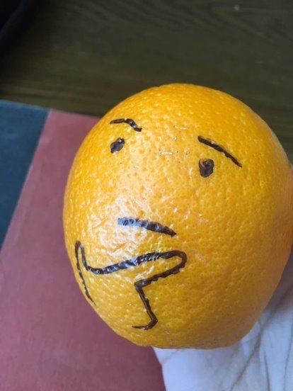
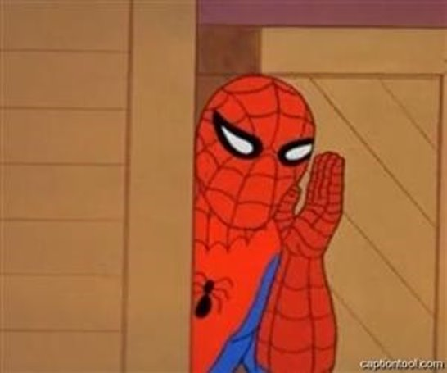

Slide 8
Think and Talk
Think about people with disabilities or different abilities.
Include them in planning events.

Slide 9
Events
Communication
Meetings
Special Events
Email
Flyers
Websites
Social Media
Text Messages
Raven

Slide 10
Hosting Accessible Events​
For People with Physical Disabilities
Is the location accessible to a person who uses a wheelchair or other mobility device?
If the event is on an upper floor, is there an elevator?
Are restrooms accessible and close to the meeting area?
Is disabled parking available nearby?
Is cart service available?

Slide 11
Hosting Accessible Events​
For People with Sensory Disabilities (Vision/Hearing)
Have you arranged for an interpreter, captionist, readers, or scribes to be present at your event?
Have you arranged for assistive equipment that may be required?
Have you provided advance copies of presentation materials/outlines those who need it?
Are materials available in accessible or alternate formats?

Slide 12
Hosting Accessible Events​
For People with Learning Disabilities
If slides or overheads are used will the information be available in an alternative format?
Is the information posted online for easy access?
Is private space available for those who need quiet time?

Slide 13
Hosting Accessible Events​
Planning for Other Needs
Are you familiar with service animal guidelines?
Have you designated the event a fragrance-free zone?
Are charging stations and power outlets available for charging devices and electric wheelchairs?
Are presentation materials in a clean design with clear language?
Are food options available for special diets?

Slide 14
Hosting Accessible Events​
Planning for Other Needs
Make sure water is available to attendees
Notify attendees in advance of changes to location, menu, materials, etc.
If participants request accommodations reach out to OIT or DRS to get specific tips on how to make your event accessible
Respect confidentiality; disclosed disabilities are not intended to be shared without the person’s permission

Slide 15
​Disability Etiquette​
The Basics
Ask before you help and be gracious about requests
Use ‘Person First’ language
Respect wheelchairs as personal space
Be aware of hidden disabilities
Speak to the person, not the interpreter
Use orienting language
No not engage with service animals unless invited

Slide 16
Designing Your Presentations
Color Contrast
Easy to Read / The Invisible Presenter
Text Size
Easy to Read / I’m getting a headache looking at it
Word Choice
Keep it Simple / Eschew, Obfuscation
Font Choice
Readable / What the Heck is It?

Slide 17
When in doubt. . .
Ask
That’s it.
No, really, just ask.
Seriously, just ask, you’ll be surprised at how effective it is.
Would I lie to you about this?

Slide 18
Questions?
For More Information:
Marvin Williams, Director, DRS
mewilliams@csustan.edu

