Slide 1
25Live PRO
Refresher Training for
Student Event Coordinators

Slide 2
25Live PRO What is 25Live?
25Live is used for University courses, meetings, events and activities
Departments that review 25Live event request information:
UPD runs a daily report to see what is taking place on campus
Safety and Risk reviews event requests to ensure events are safe and the University is following safety and university guidelines
Facilities Services runs reports to see when the HVAC should be scheduled on/off
OIT is notified of requests for technology support for events
Location approvers review event requests to ensure they are happening in an appropriate location

Slide 3
25Live PRO Who has access to 25Live?
All University Users with Warrior ID credentials can access information in 25Live.
After logging in, students have access to make Express Scheduling requests only (this is for individual/group study rooms)
After you’ve logged in, SLD will need to update your permissions
Once permissions are updated, you will have access to the “Event Form”
If you are a SEC and a Student Assistant for a department on campus that needs to input event requests, you will need to notify SLD. They will give you access to more event types that you will need for dept events.
Only student organization requestors are permitted to input student organization events, NOT your staff advisor. Faculty & Staff have different settings than student organization requestors.

Slide 4
25Live PRO How do I Access 25Live?
Direct Link
25live.collegenet.com/pro/csustan
Stan State 25Live Website
www.csustan.edu/25live
IMPORTANT:
Must use Google Chrome
Internet Explorer/Firefox is not recommended
Logging In:
You will log in using your Warrior ID

Slide 5
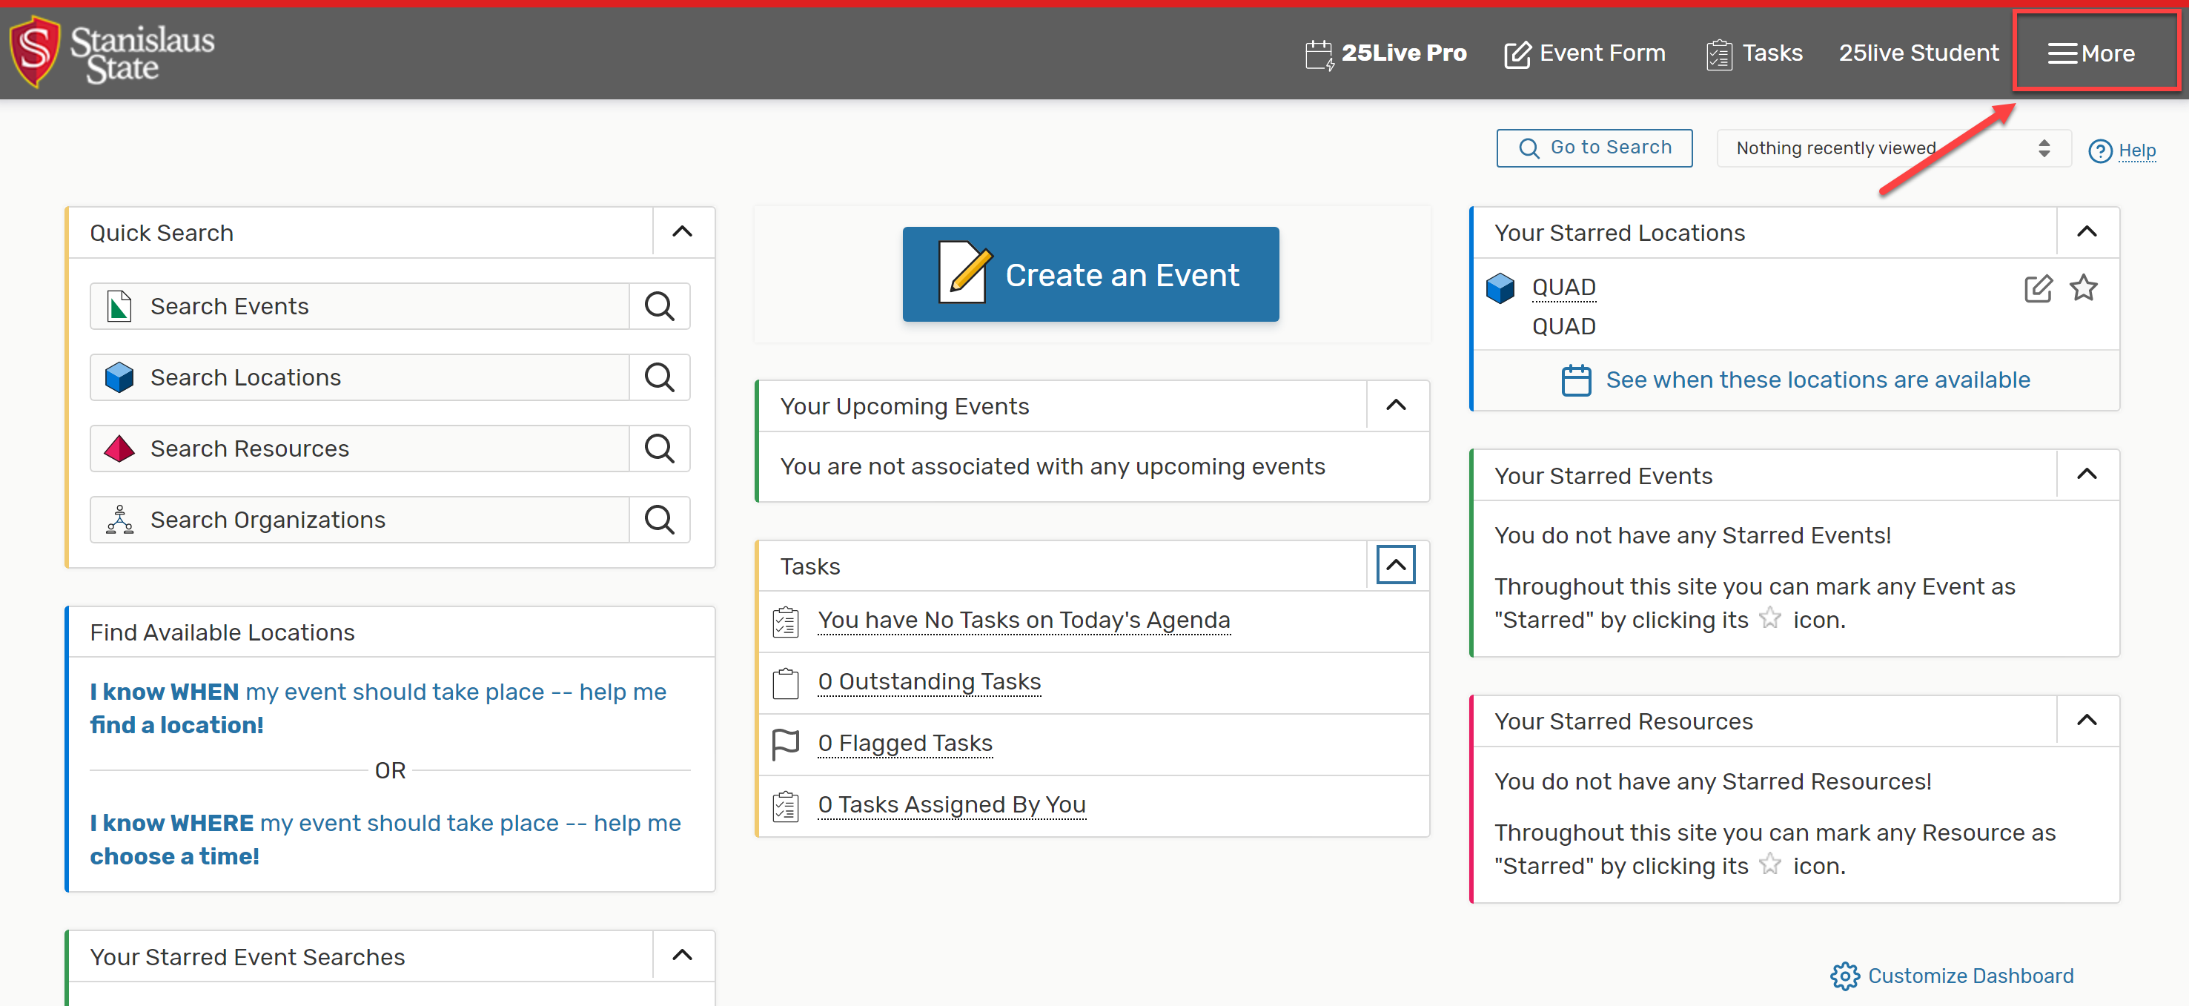
25Live PRO “More” Menu

Slide 6
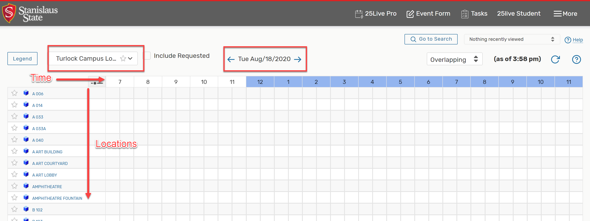
25Live PRO “Availability”
“More” Menu > Availability > Select date from date picker
Time: each box represents 30 minutes
Locations: Can choose a different location search from the dropdown

Slide 7
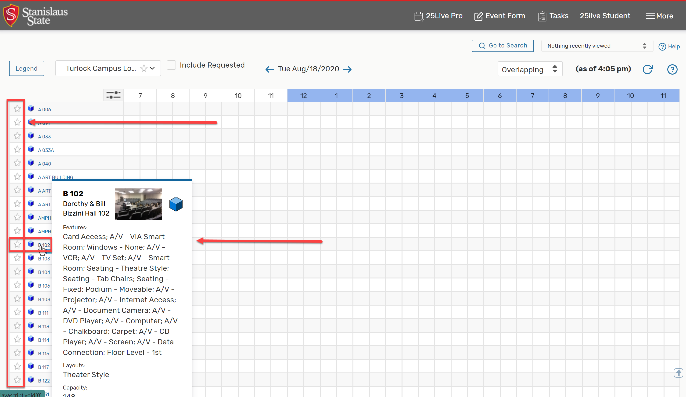
25Live PRO “Availability”
Click on the blank star to make a frequently used location a “Starred Location”
Hover over a location name to view limited information
Click on the location name to view additional information

Slide 8
25Live PRO “Availability”
Once you add some “Starred Locations”, refresh your browser, then choose “Starred Locations” from the dropdown menu

Slide 9
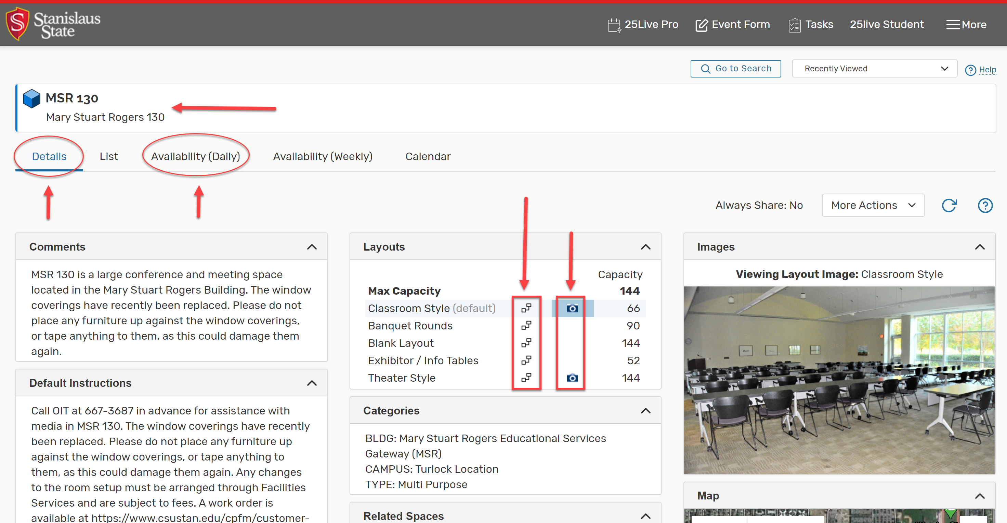
25Live PRO “Location Details”
Keywords you can search by
Layout Diagrams
Layout Photo
Layout Diagrams can open in another window so you can print!

Slide 10
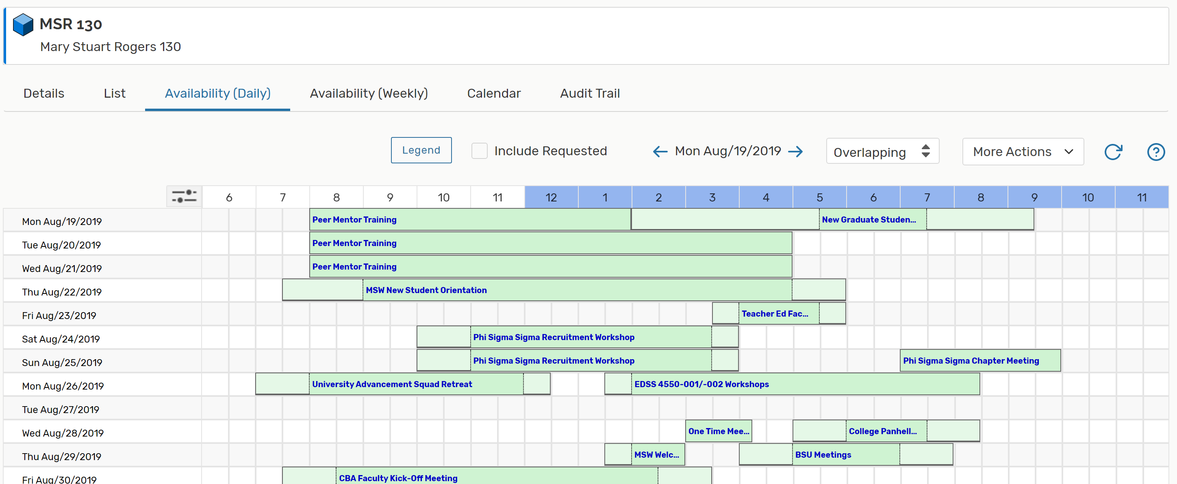
25Live PRO “Location- Availability (Daily)”
“Availability (Daily)” shows you 30 days at a time.
Very helpful for seeing the “gaps” and when you can schedule.

Slide 11
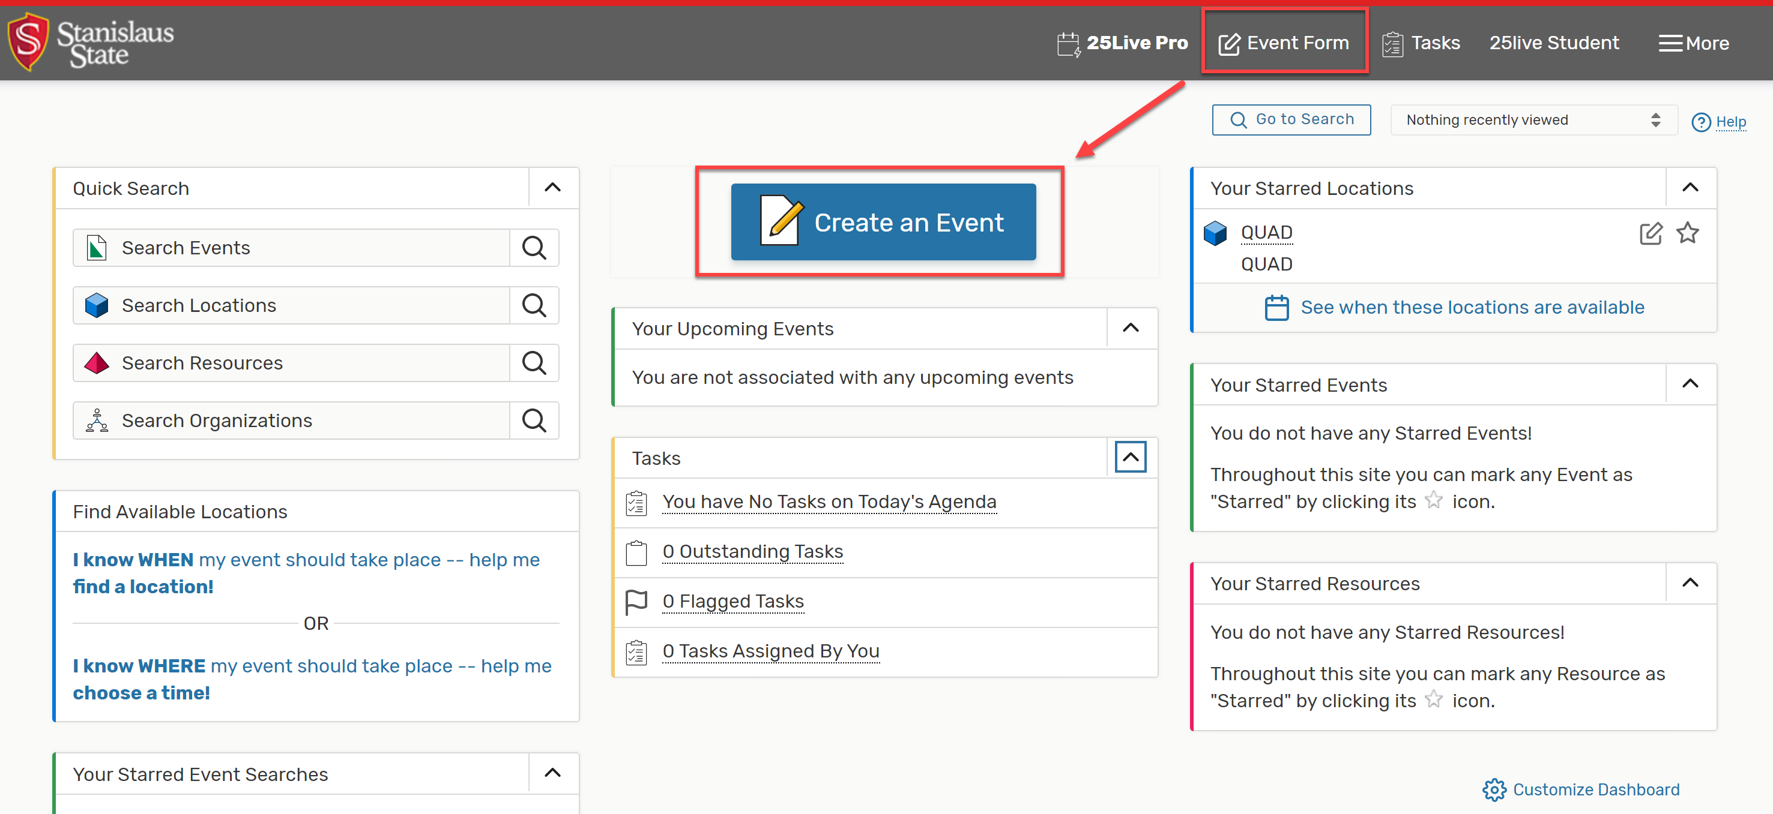
25Live PRO “Event Form”
To create an event, click on “Create an Event” or “Event Form”
If you do not see “Create an Event”, then you do not have the right permissions

Slide 12
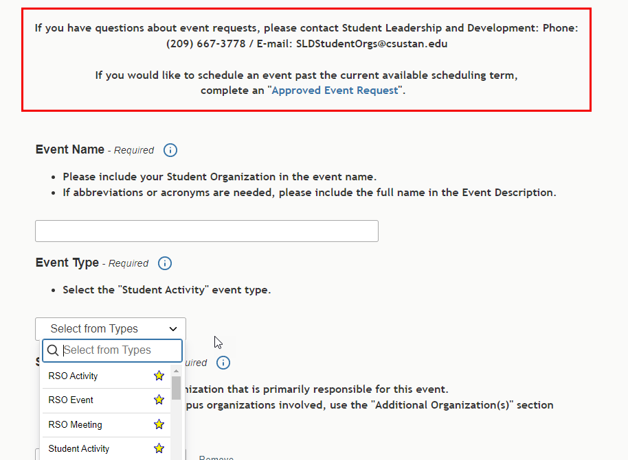
25Live PRO “Event Form”
Please keep in mind that if you have questions, contact the SLD office.
Future Event requests for events past the current reservation dates.
New Event Types labeled with “RSO”

Slide 13
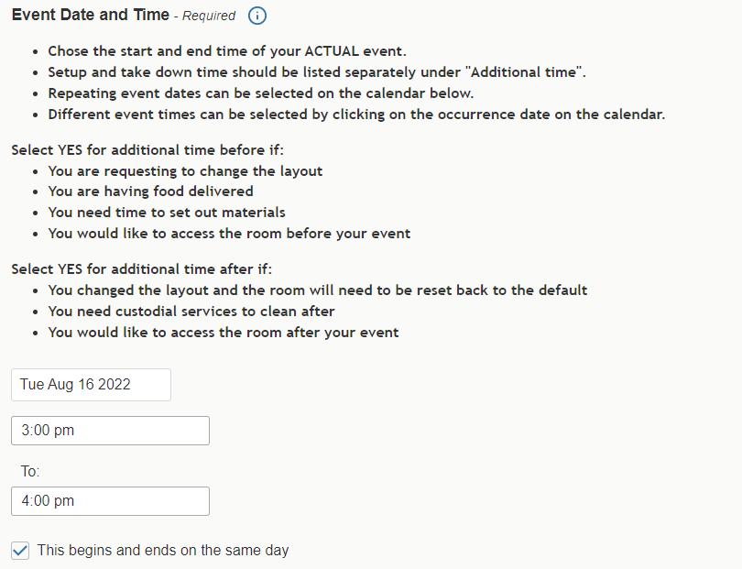
25Live PRO “Event Form”
Do NOT include setup/takedown time in the event time.
Events do NOT typically go overnight, so keep “this begins and ends on the same day” selected.

Slide 14
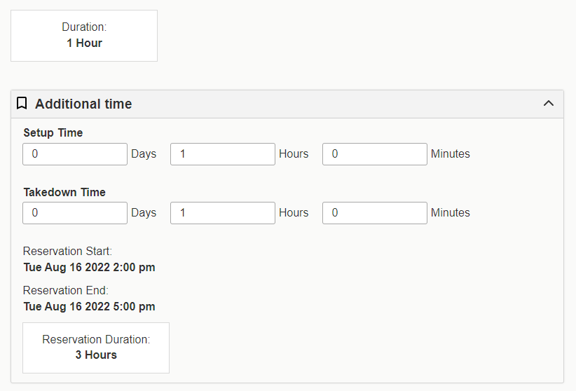
25Live PRO “Event Form”
Event Duration is different than Reservation Duration if you add setup/takedown time.

Slide 15
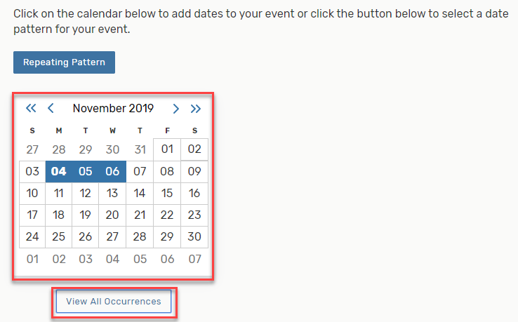
25Live PRO “Event Form - Repeats”
Add reoccurring dates by clicking on the calendar date.
Click on “View All Occurrences” to edit the event times on multiple occurrences or even add another occurrence on the same day.

Slide 16
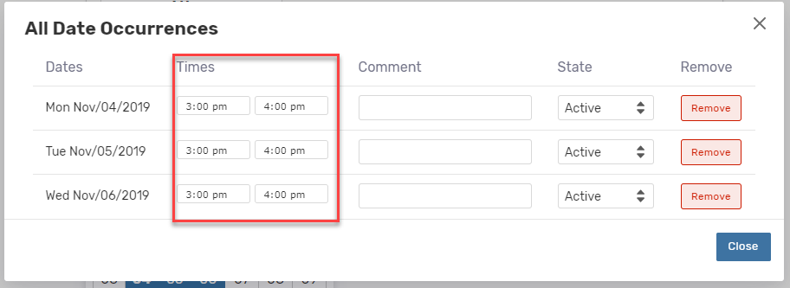
25Live PRO “Event Form - Repeats”
You can change the event time/duration on multiple occurrences AND add multiple occurrences on one day.
*The setup and takedown durations remain the same on each date.*

Slide 17
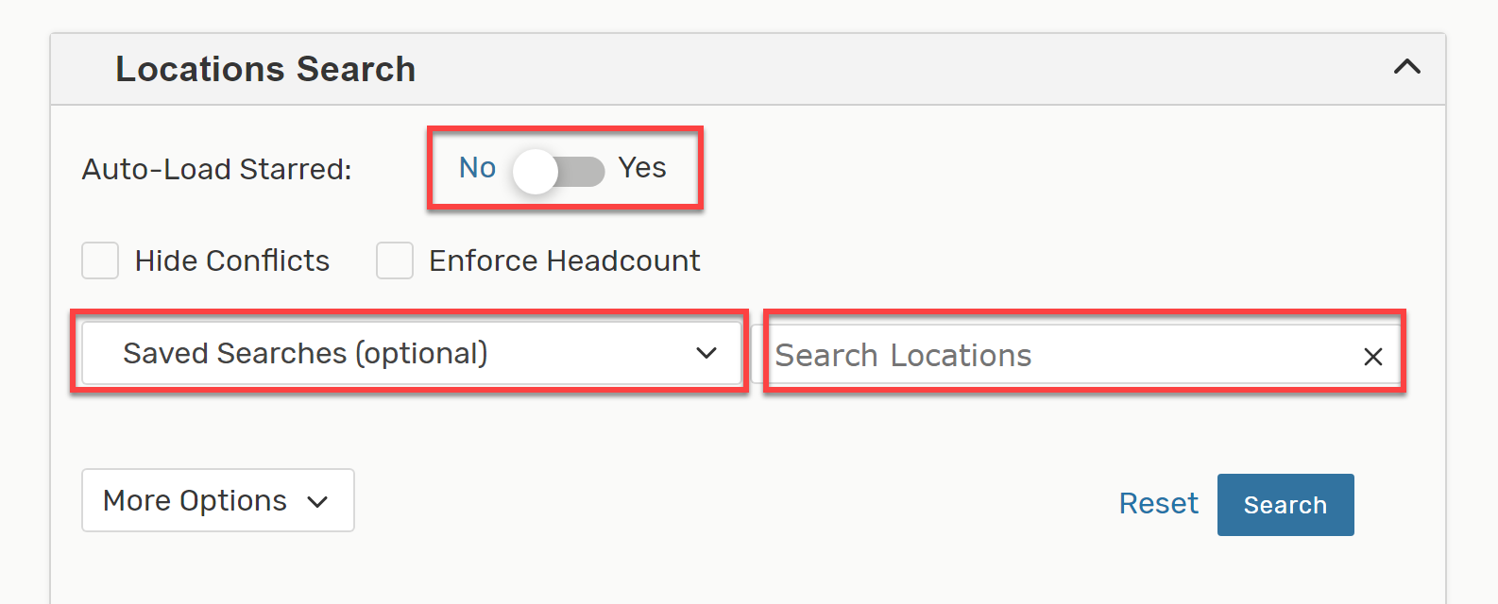
25Live PRO “Event Form – Location Search”
You can choose to:
1. Auto-load your starred locations
2. View a public saved search
3. Search by name/keyword

Slide 18
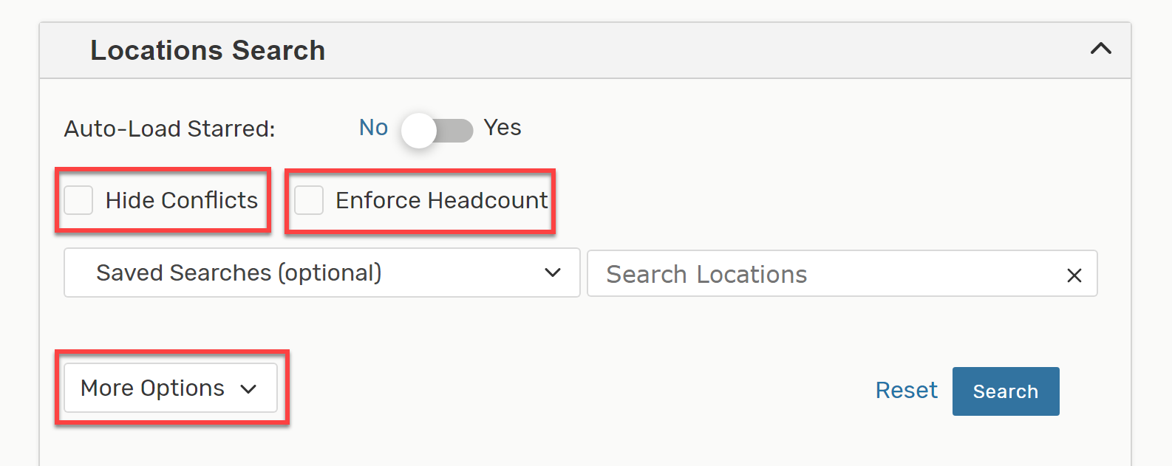
25Live PRO “Event Form – Location Search”
You may also:
Hide locations with conflicts
(UNCHECK THIS FOR ONLINE/VIRTUAL EVENTS!)
2. Show only show locations that fit your headcount
3. Search by parameters such as categories, features, layouts

Slide 19
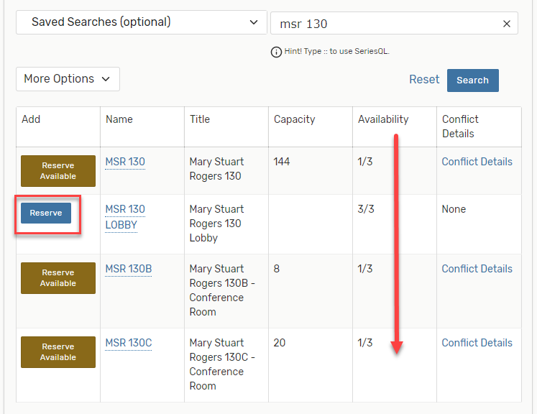
25Live PRO “Event Form – Location Search Results”
= the location is available for all the dates selected.
= the location is available for some of the dates selected. Click on “Conflict Details” to see conflict information.
= the location is not available for any of the dates selected.
= the location does not exist in the system OR you do not have permissions to reserve.

Slide 20
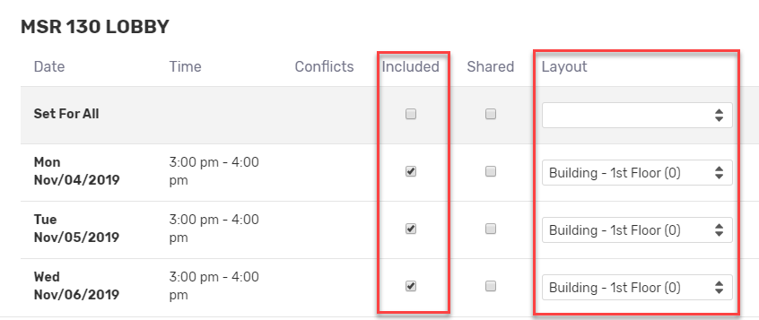
25Live PRO “Event Form – Location Search”
Click on “View Occurrences” to unselect a location for an occurrence date (uncheck “included”), or to change the layout from the dropdown options.

Slide 21
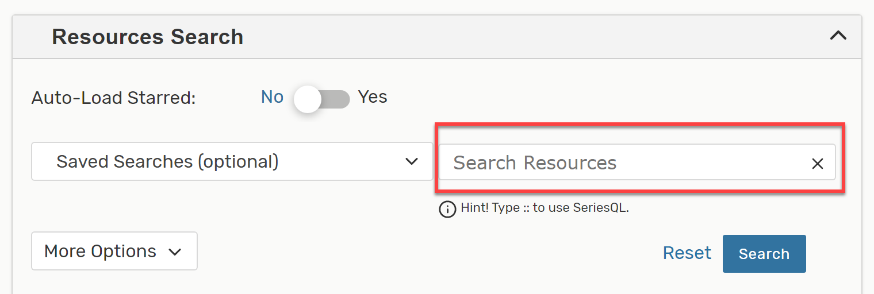
25Live PRO “Event Form – Resources Search”
Resources are where you can request additional equipment and services.
Equipment is typically for specific locations,
such as the QUAD, Student Center, or Event Center.
Please only select equipment that is labeled for the
corresponding location you have requested.

Slide 22
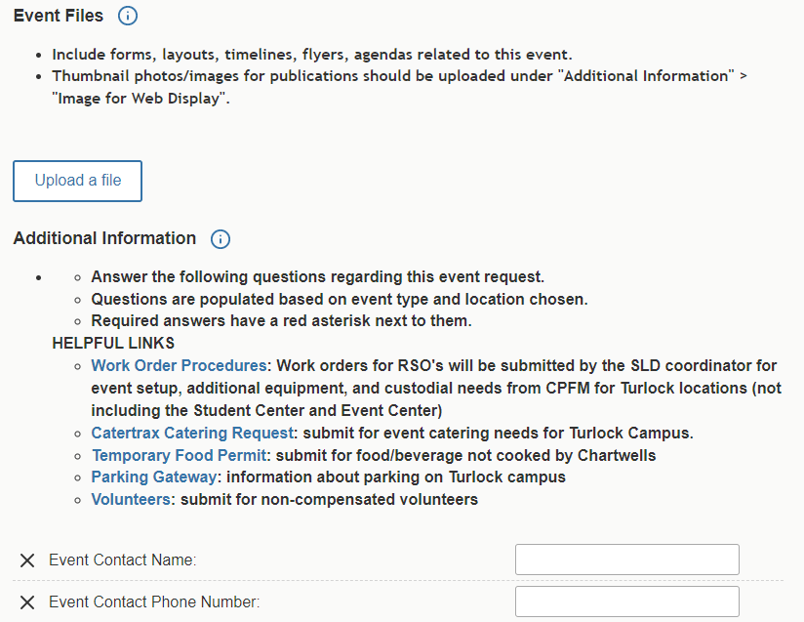
25Live PRO “Event Form – Event Files and Additional Info”
Upload additional information in event files for large events.
Answer ALL questions accurately and completely. The more information, the better to assist you!

Slide 23
25Live PRO “Event Form –Additional Info”
Some selections are all that are needed to request the service.
OIT Tech/Media/Network Services Work Order Request Needed?
Publication Request to Promote this Event? - 2 weeks in advance
Event Setup in Student Center/Event Center?
Others require additional action to be completed.
Custodial/Event Setup Work Order? - 2 weeks in advance
Food/Beverage Served?
Co-Sponsorship? - 1 month in advance
Off-Campus Service Provider?
Physical Activity/Game/Sport? - 2 weeks in advance
Dignitary/Elected Official Invited?
Off-Campus Youth? - 2 weeks in advance

Slide 24
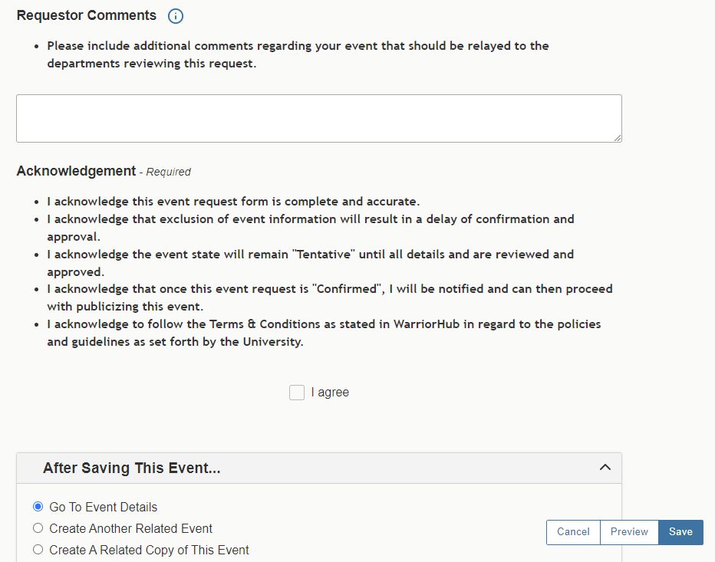
25Live PRO “Event Form – Requestor Comments & Save”
Add any comments you would like only the scheduler to view, such as additional questions or assistance needed.
Click “I agree” and “Save” to complete your request

Slide 25
25Live PRO “Event Form – Save”
If you do NOT see this notification and the system doesn’t take you to the Event Details page at the end of your request, it did NOT save!
The system will jump you up to the section that is missing information, so pay attention to what’s on the screen, complete what is missing, and try to save again.
If you are still having issues, please contact SLD immediately. It is easier to assist while you are in the reservation instead of after you have closed out.

Slide 26
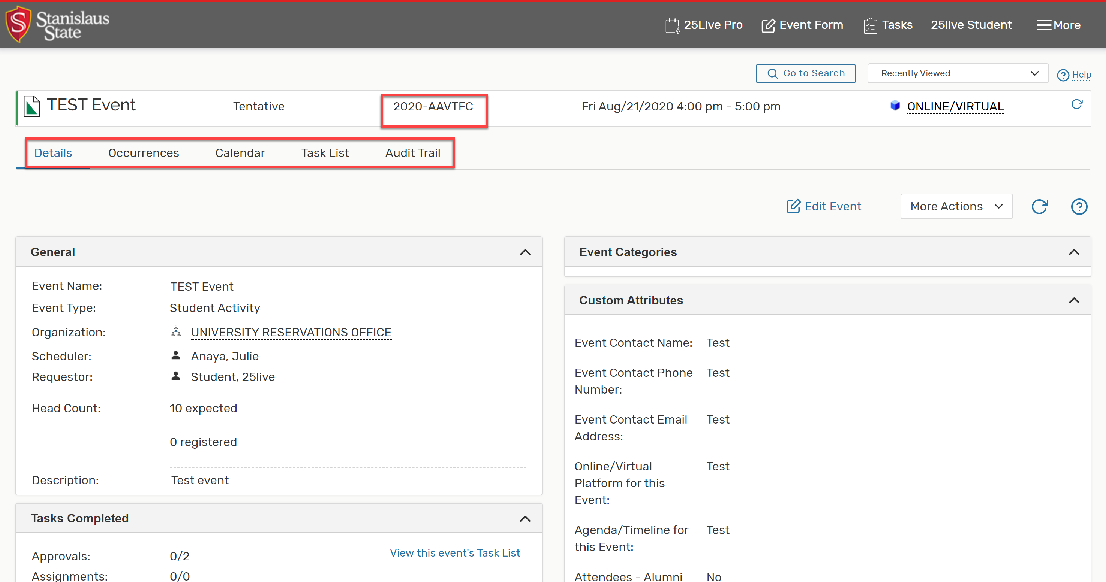
25Live PRO “Event Details”
This is your reference number.
It is ESSENTIAL that you visit the Event Details page to review your event information for accuracy!

Slide 27
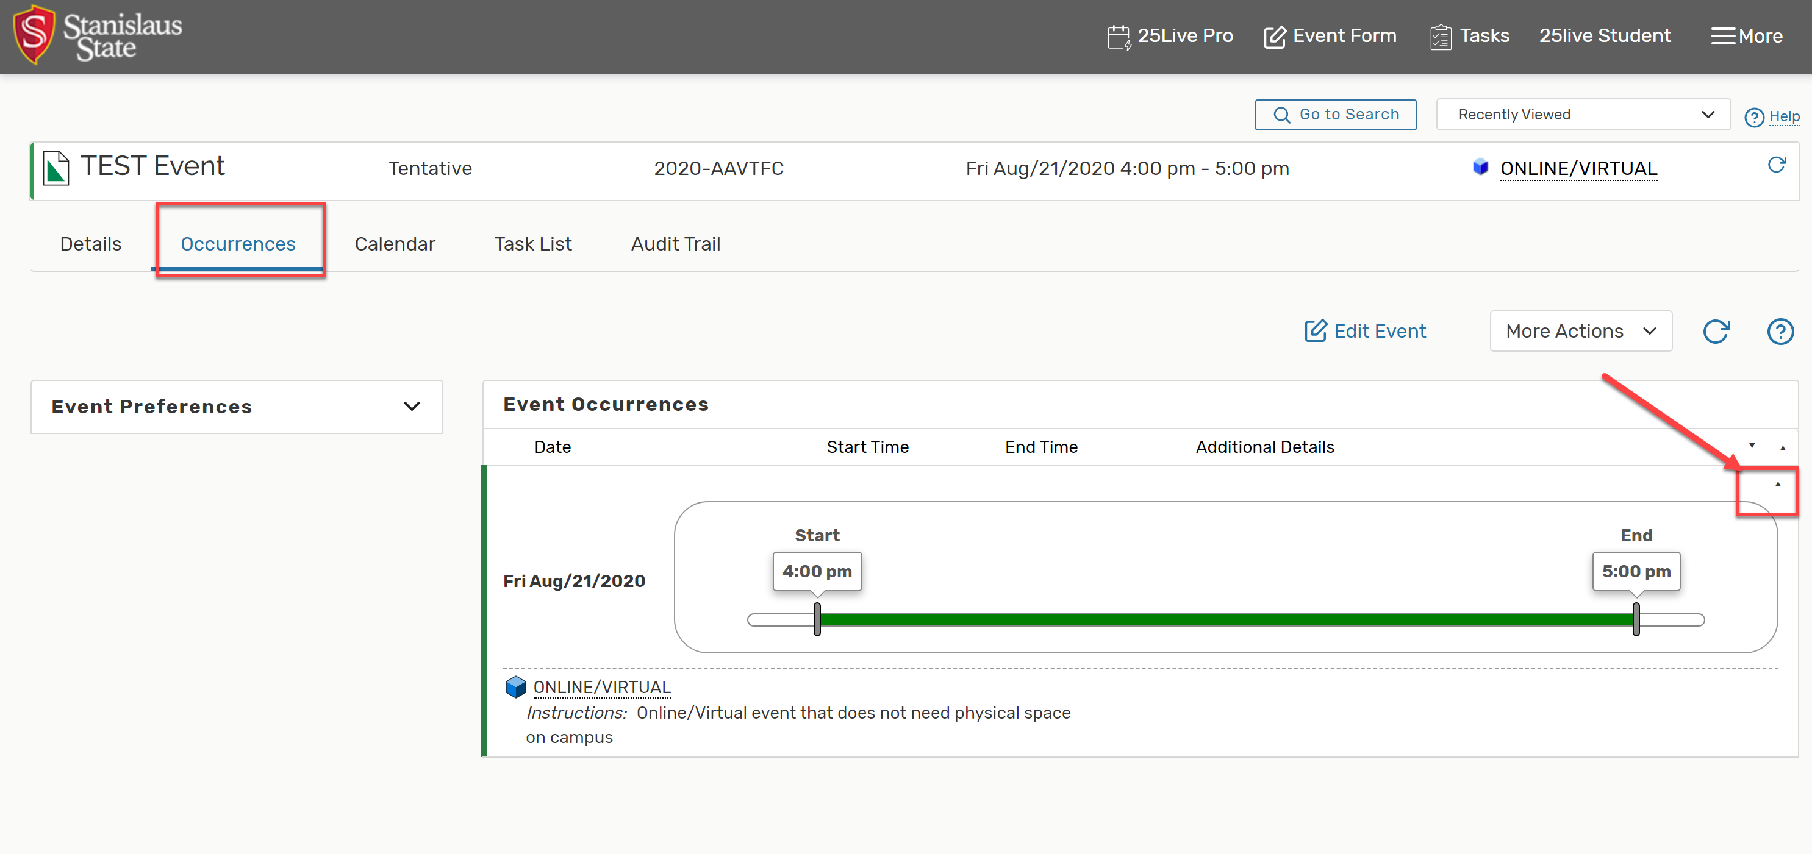
25Live PRO “Event Details- Occurrences”
The “Occurrences” tab shows you all the event times you have scheduled in this event request. Please visit this tab to review your request to ensure accuracy for all dates!

Slide 28
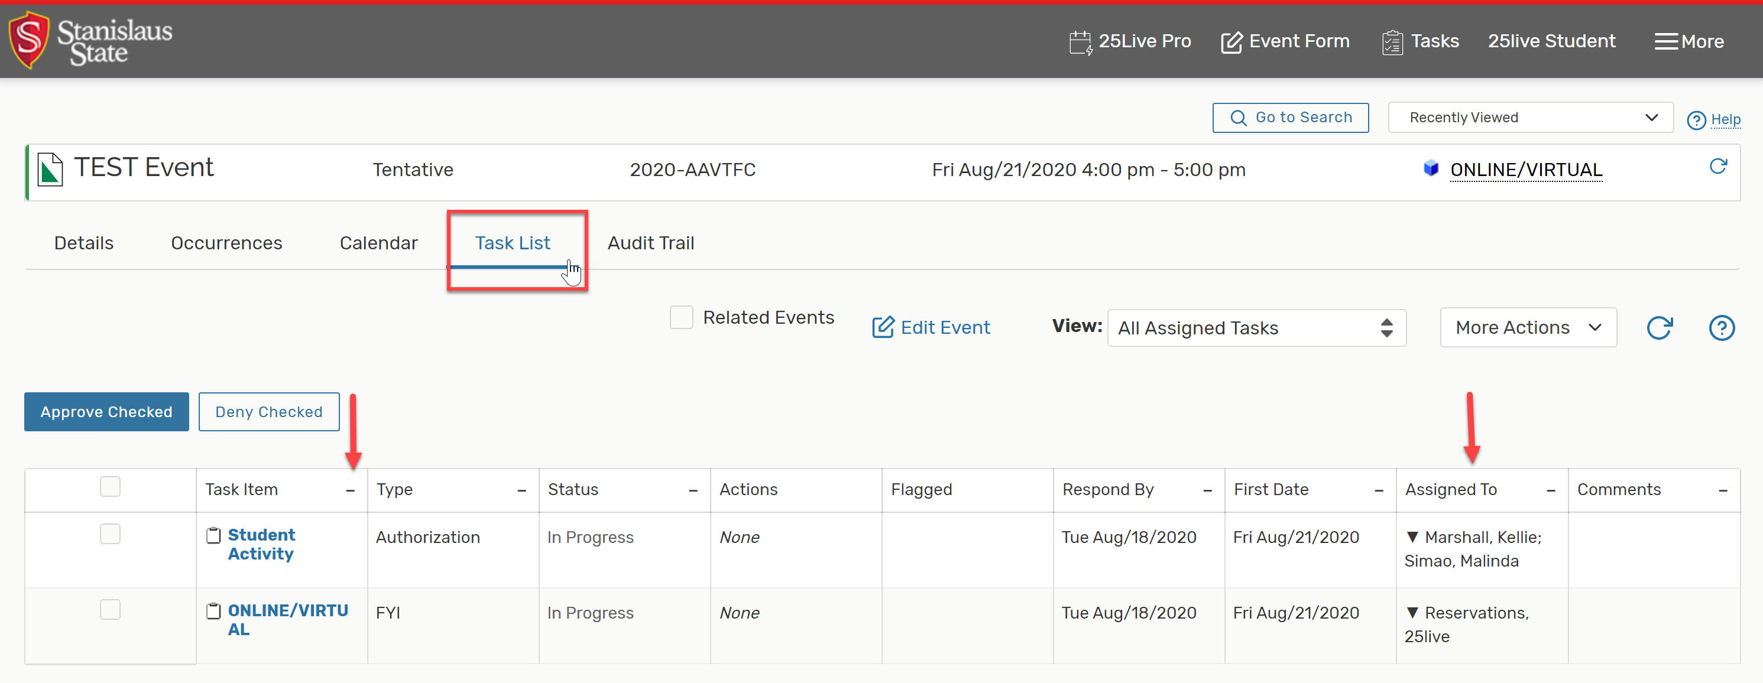
25Live PRO “Event Details- Task List”
The task list shows you who was notified regarding this event.
If you have questions about the status of your event, please follow up with the SLD office.

Slide 29
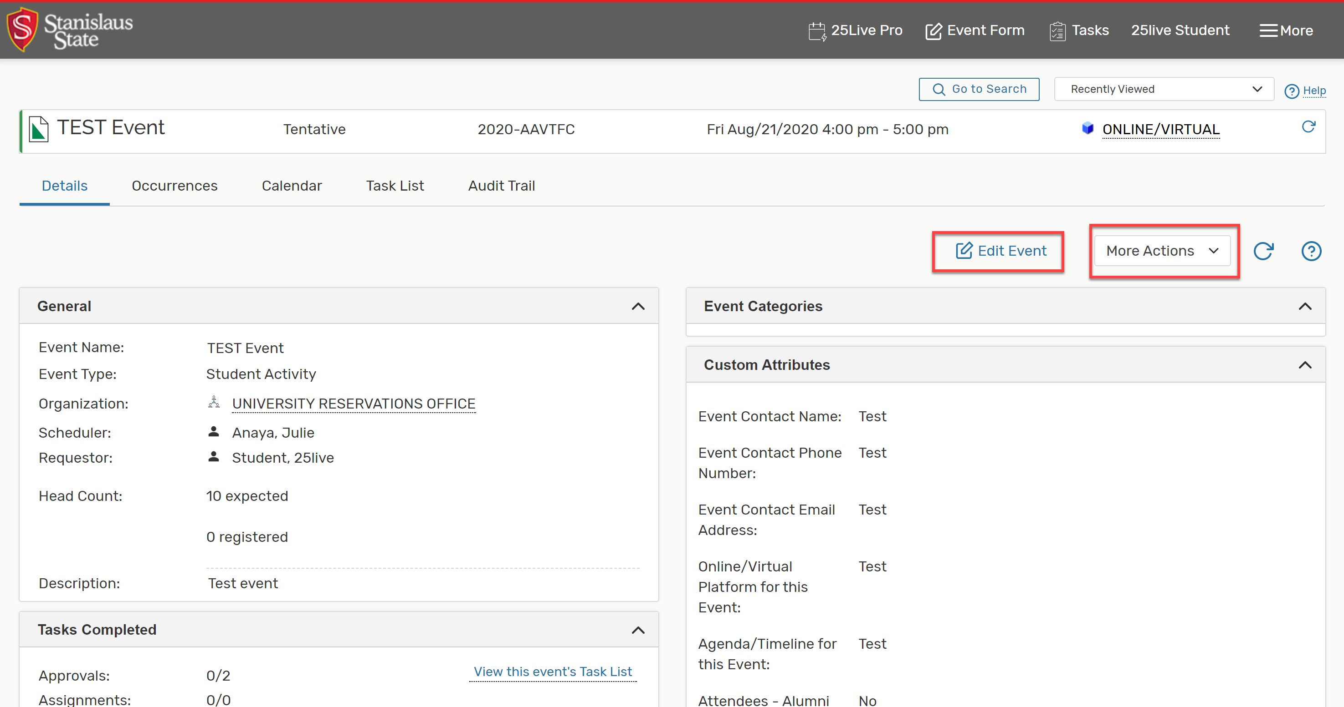
25Live PRO “Event Details- Edit”
You can edit some details of your event as long as it is still in tentative status.
For other edits, please email the scheduler.

Slide 30
25Live PRO “Event Details- More Actions”
Email Event Details:
Can email the scheduler with any changes you have.
Can email yourself or others with a link to your event request and a confirmation page.
Print a Report for this Event:
Can print a confirmation page with event details for your records.

Slide 31
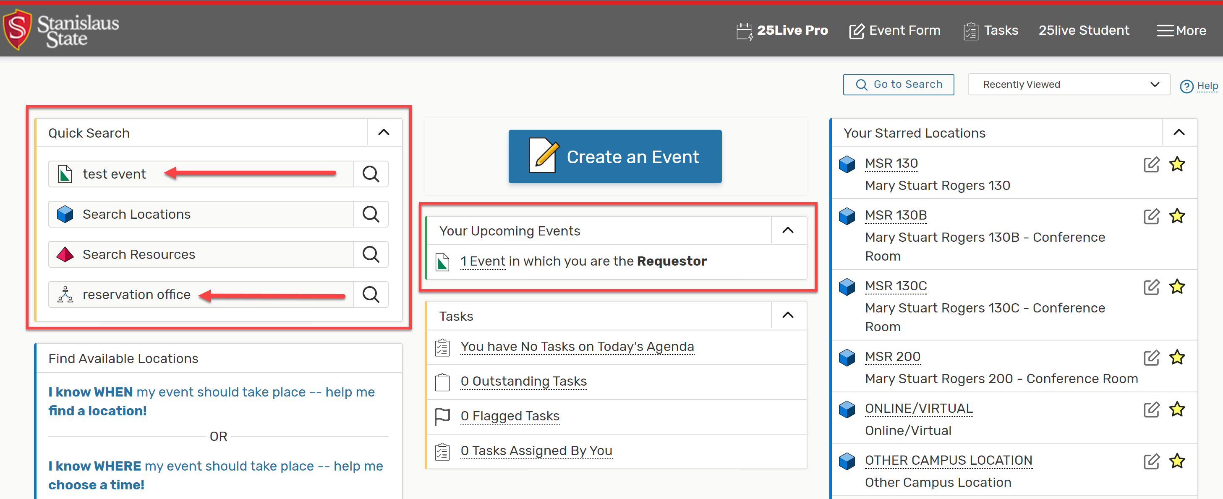
25Live PRO “Find your Event Again”
“Your Upcoming Events” will now show all events you’ve entered.
“Quick Search” also allows you to search by event name, reference number, or see all events entered by your organization.

Slide 32
25Live PRO “Next Steps”
Once you input your 25Live request, you will need your reference number to input another request in Warrior Hub.
We are looking at ways to streamline this process.
You will need to wait until these event requests are confirmed before advertising your event.
You may be asked to attend a SAFE (Safe and Fun Events) meeting to review event details and get your questions answered from SLD and other departments involved.
If you are unsure about an event you are thinking of hosting, JUST ASK! We are all here to help!

Slide 33
25Live PRO “Help” Further
If you have any questions regarding Student Organization event requests, please contact:
Student Leadership and Development
(209) 667-3778
SLD@csustan.edu

